Slide 1



END-TO-END DATA ENGINEERING PROCESS
DATA MANAGEMENT PROJECT

Slide 2





VALUES
Managing customer data to gain business insights and improve operations.
- End-to-end process including data modeling, implementation, ETL, and dashboard creation.
01
Holistic Approach: An end-to-end process ensures that data is managed from ingestion to visualization, promoting consistency and integrity throughout the data lifecycle.
02
Quality Assurance: Implementing data quality checks and governance practices helps ensure that the data used for analysis is accurate, complete, and reliable
03
Data-Driven Insights: By transforming and modeling data effectively, organizations can derive valuable insights that drive strategic decisions and improve operational efficiency.
04
Adaptable Infrastructure: A well-designed data engineering pipeline can easily scale to accommodate increasing volumes of data and adapt to changing business needs.

Slide 3


PROJECT OBJECTIVE
01
02
03
Data Modeling
Database Implementation
Data Generation
04
05
06
Data Warehouse
ETL Process
Anlaysis Query
07
Dashboard Creation

Slide 4
DATA MODELING
01

Slide 5
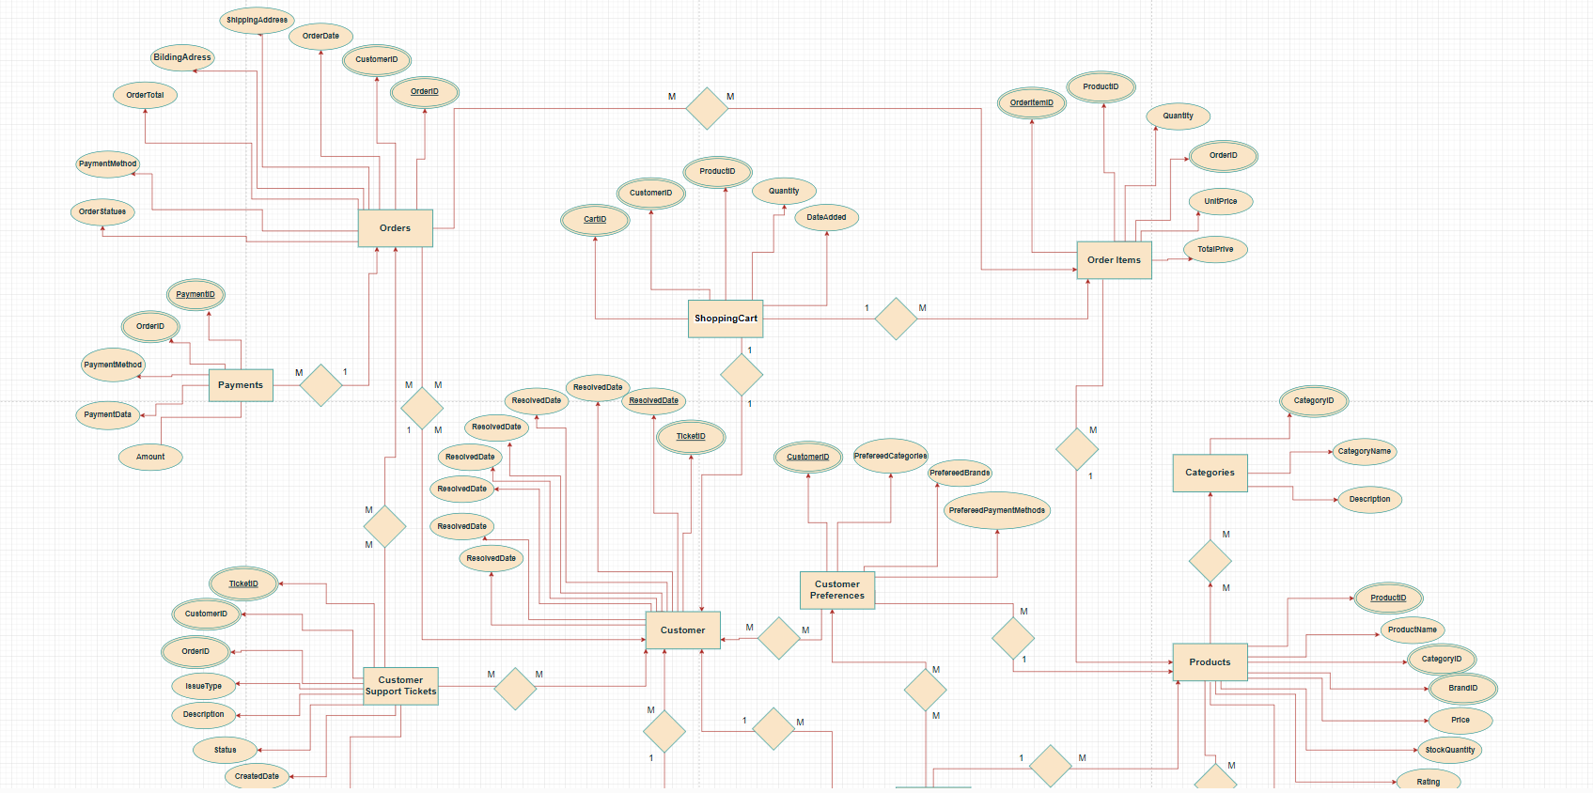
Customer Management ERD

Slide 6
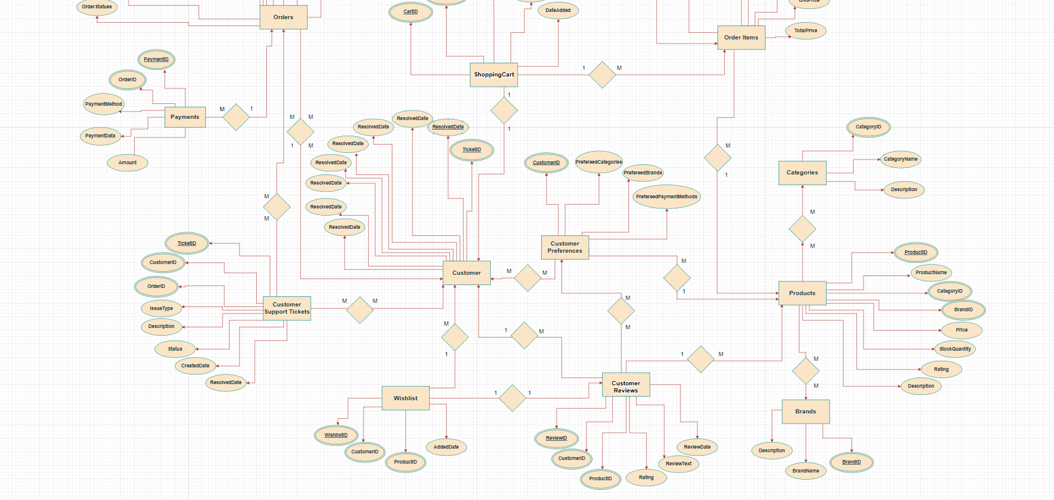
Customer Management ERD

Slide 7
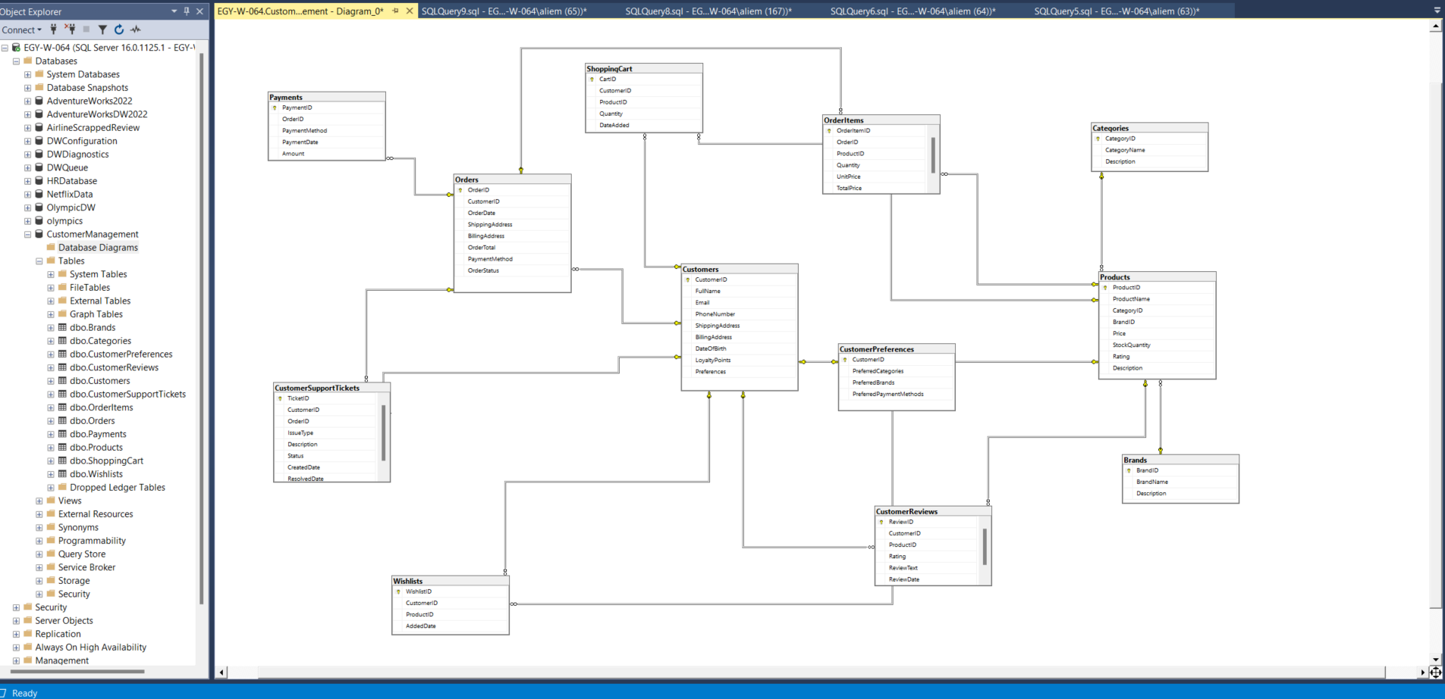
ERD Sql Server

Slide 8
02
Database Implementation

Slide 9
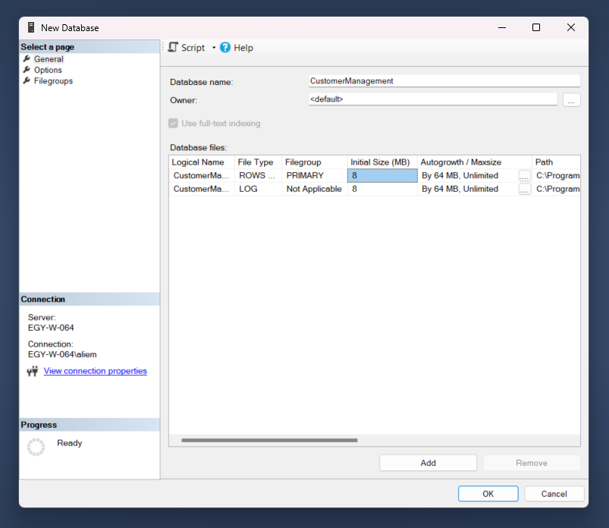

Slide 10
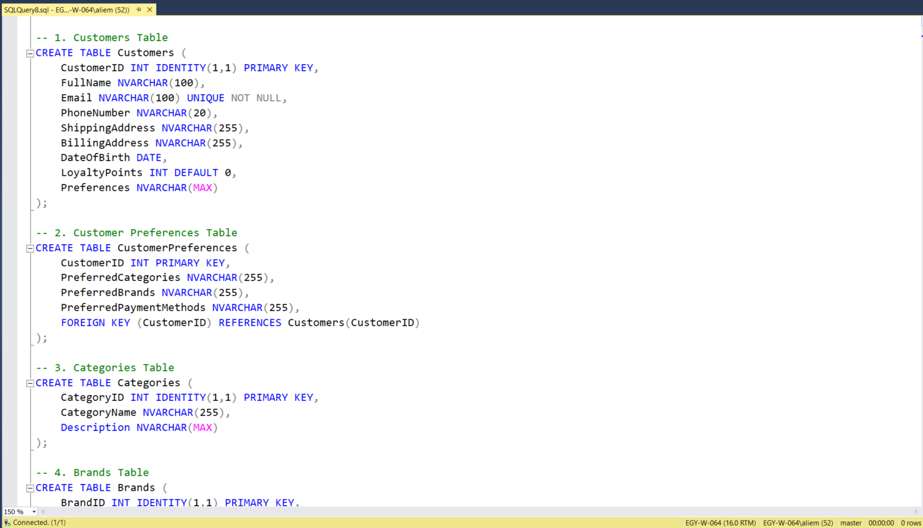

Slide 11
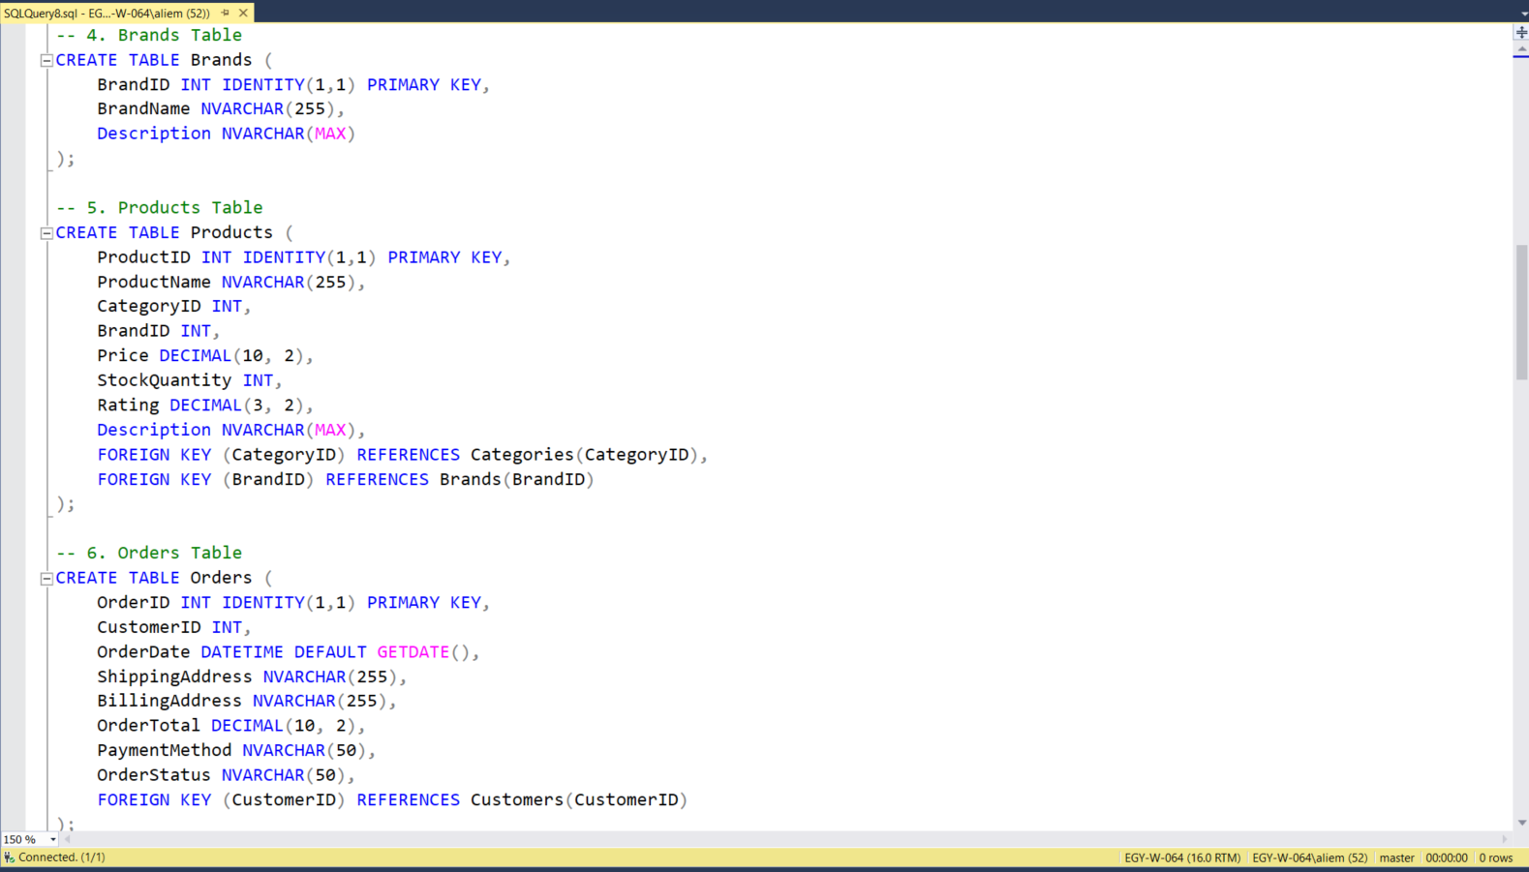

Slide 12
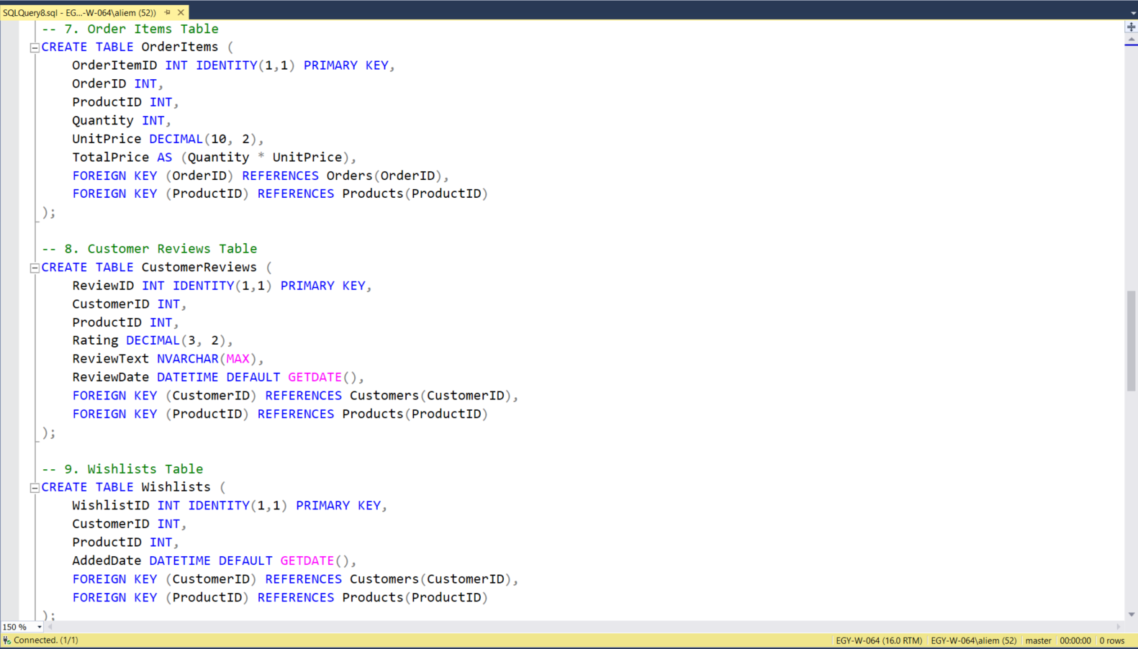

Slide 13
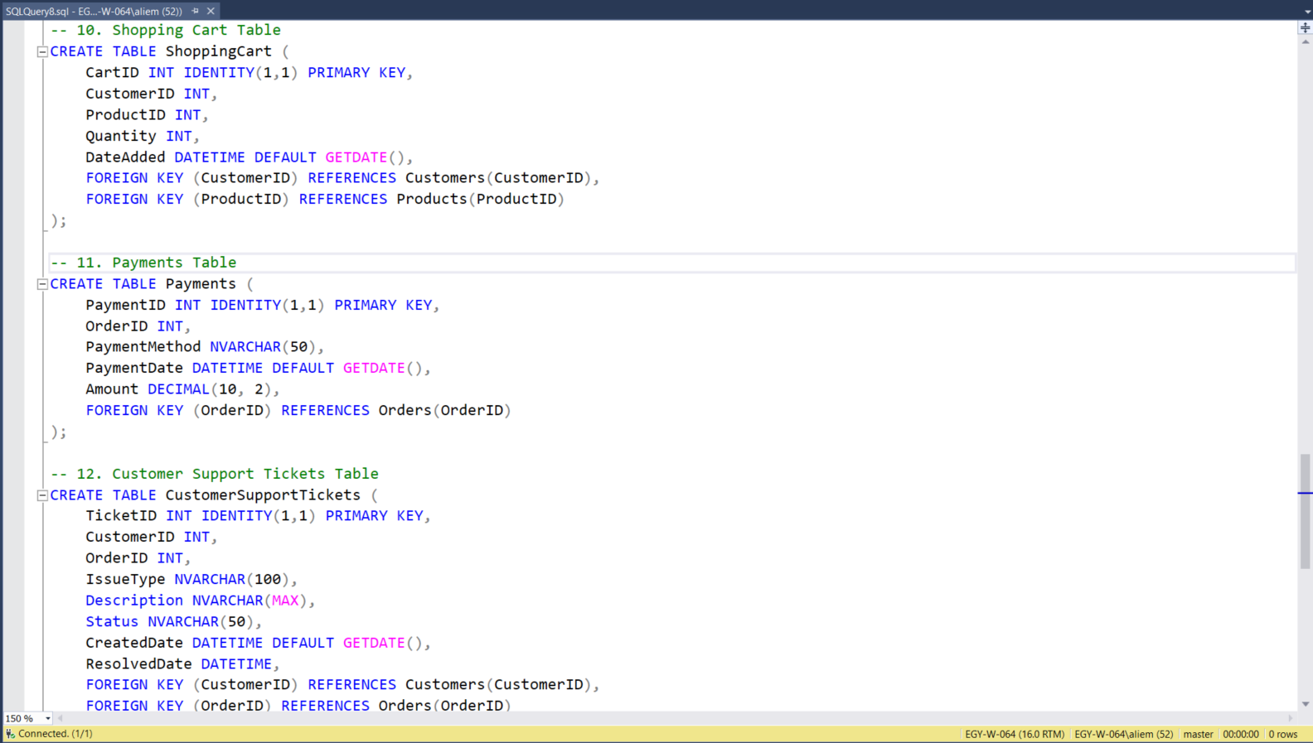

Slide 14
03
Data Generation

Slide 15
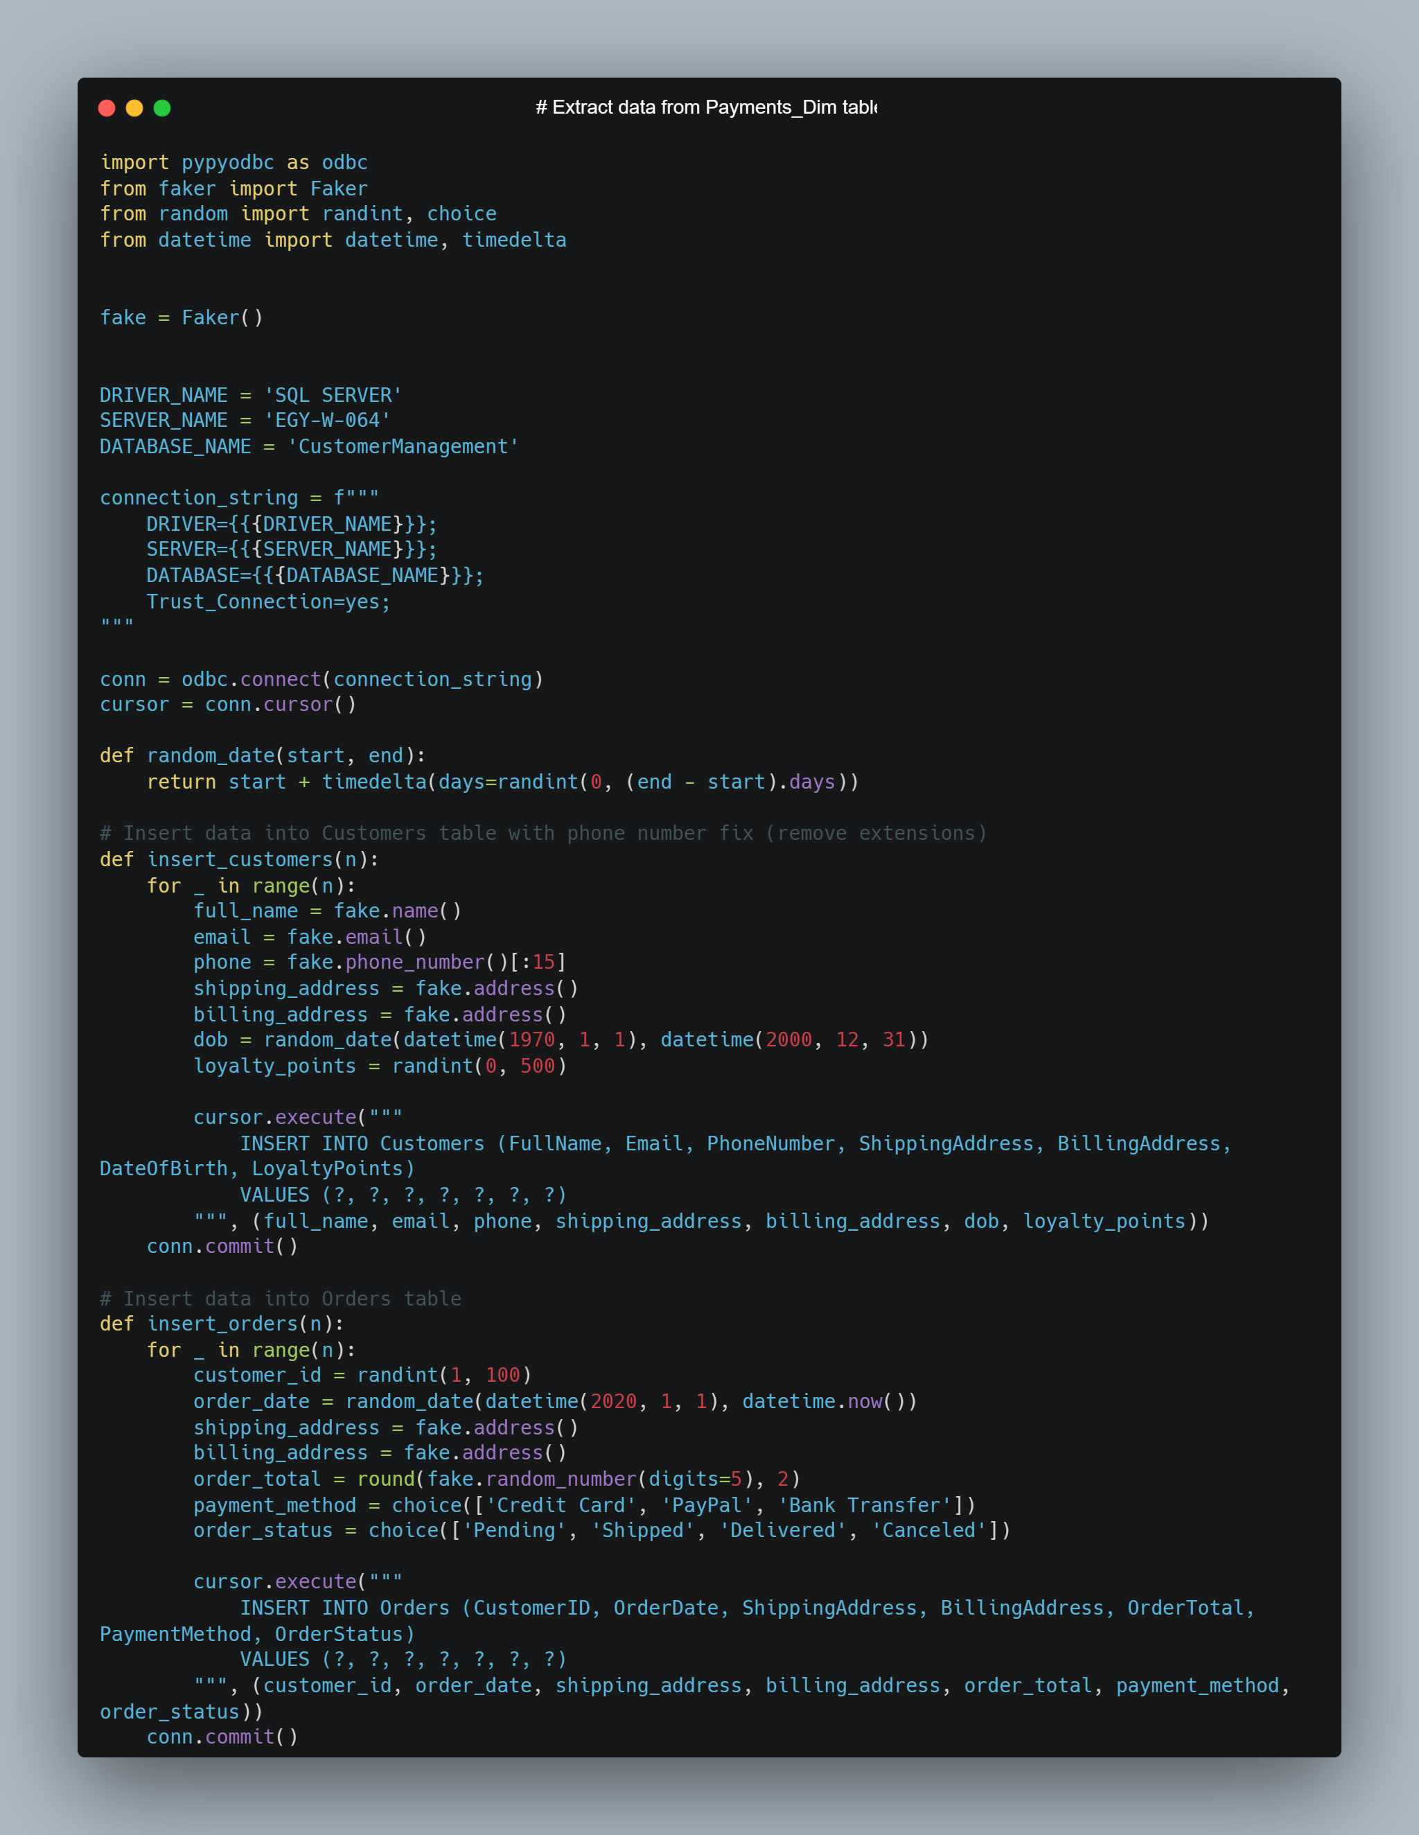

Slide 16
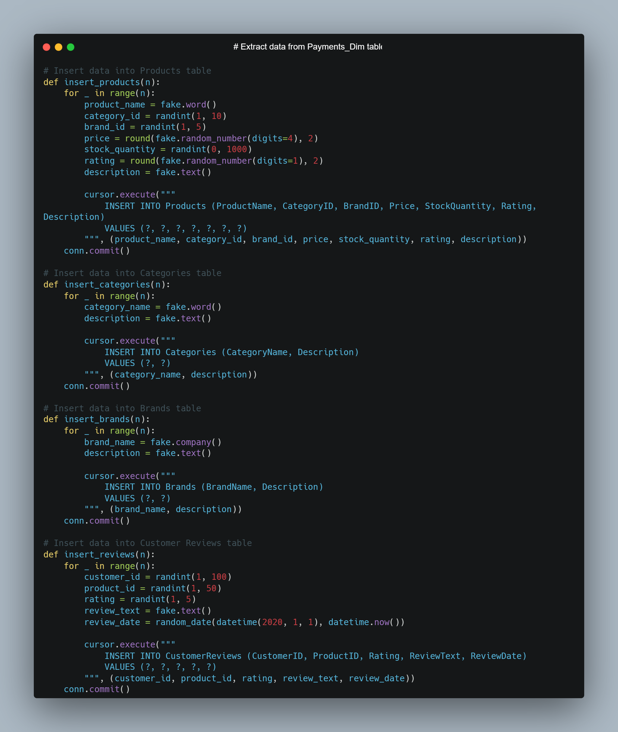

Slide 17
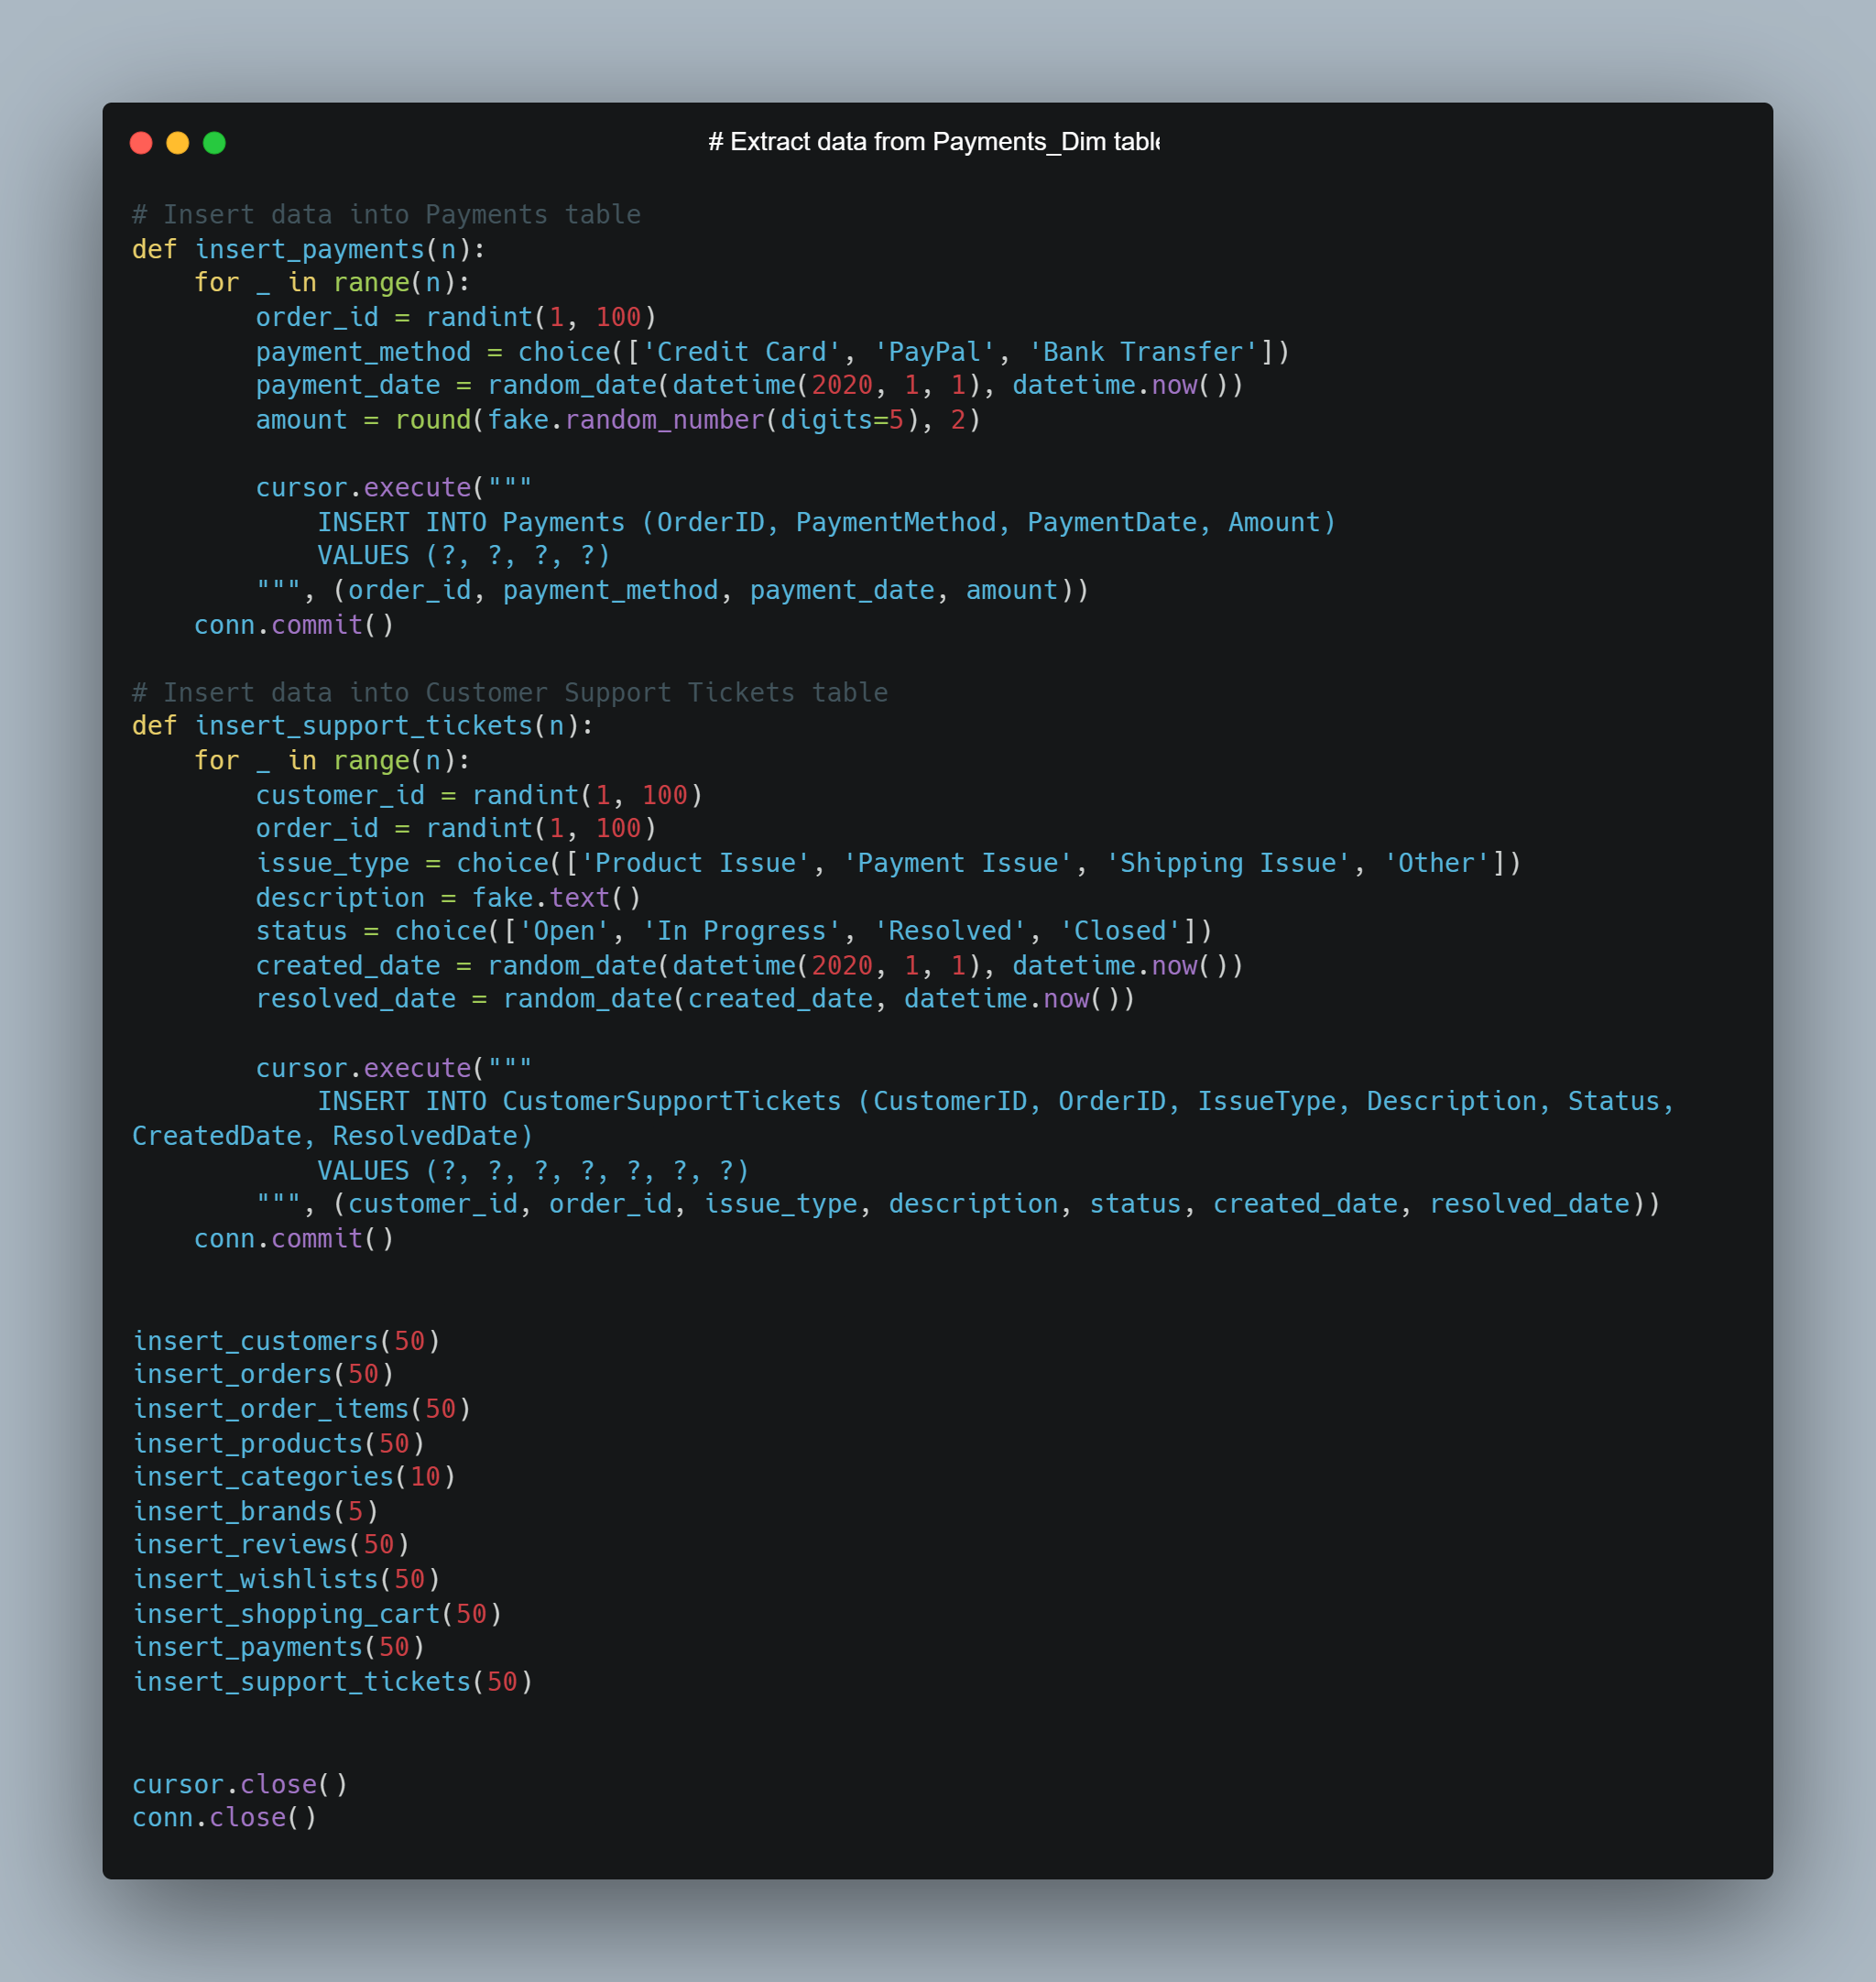

Slide 18
04
Data Warehouse

Slide 19
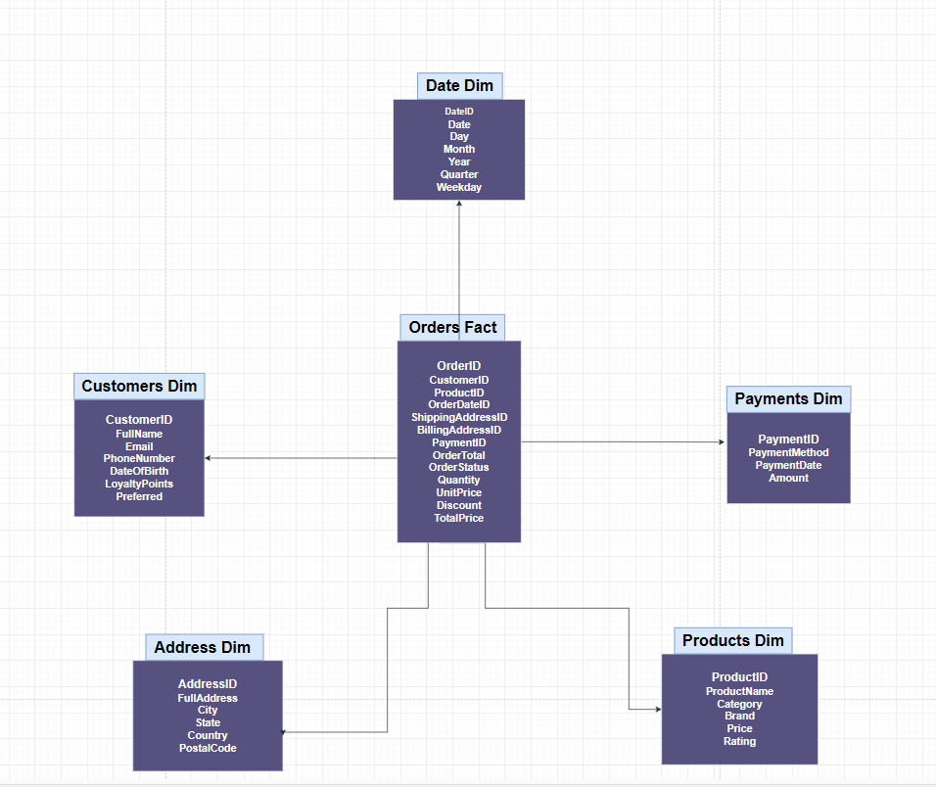
Star Schema

Slide 20
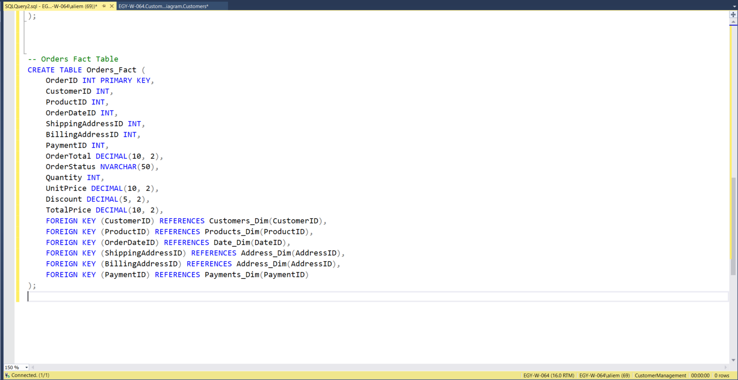

Slide 21
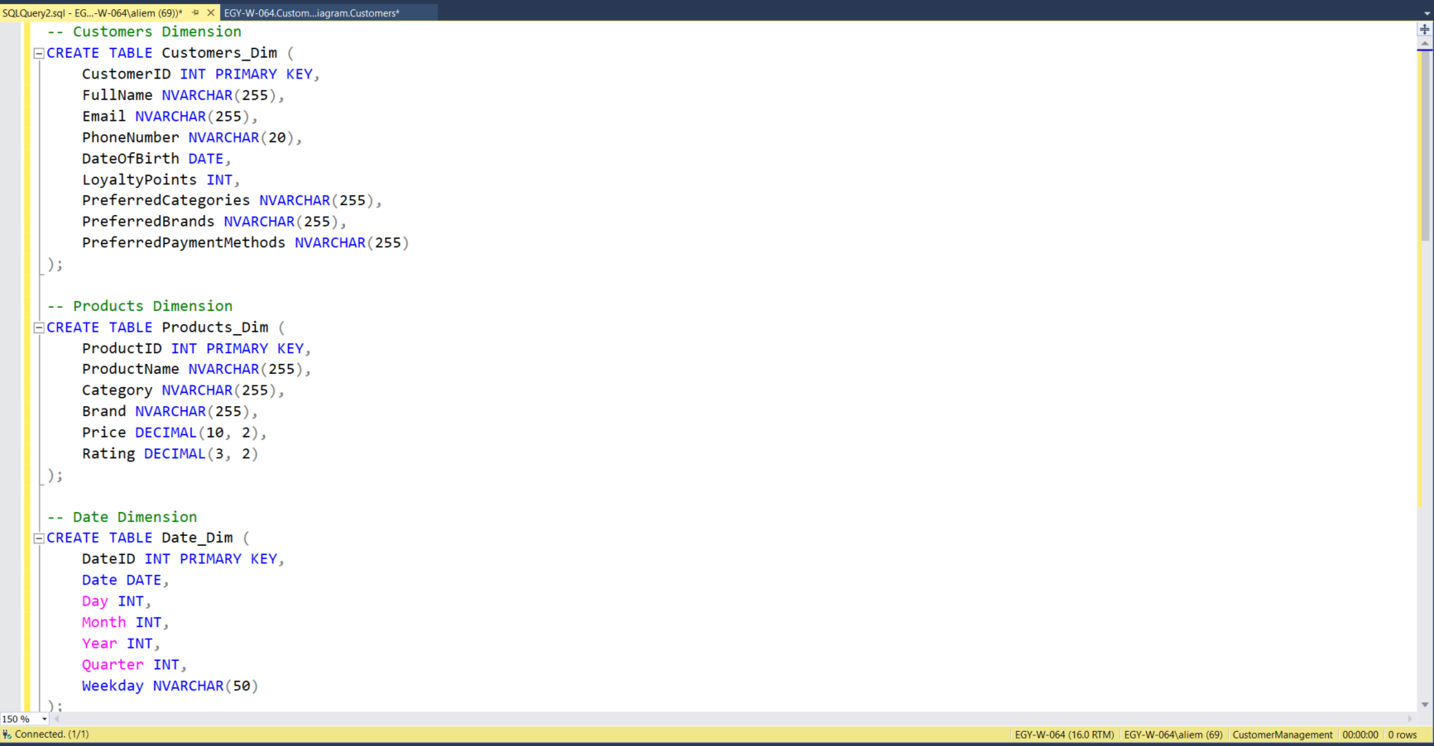
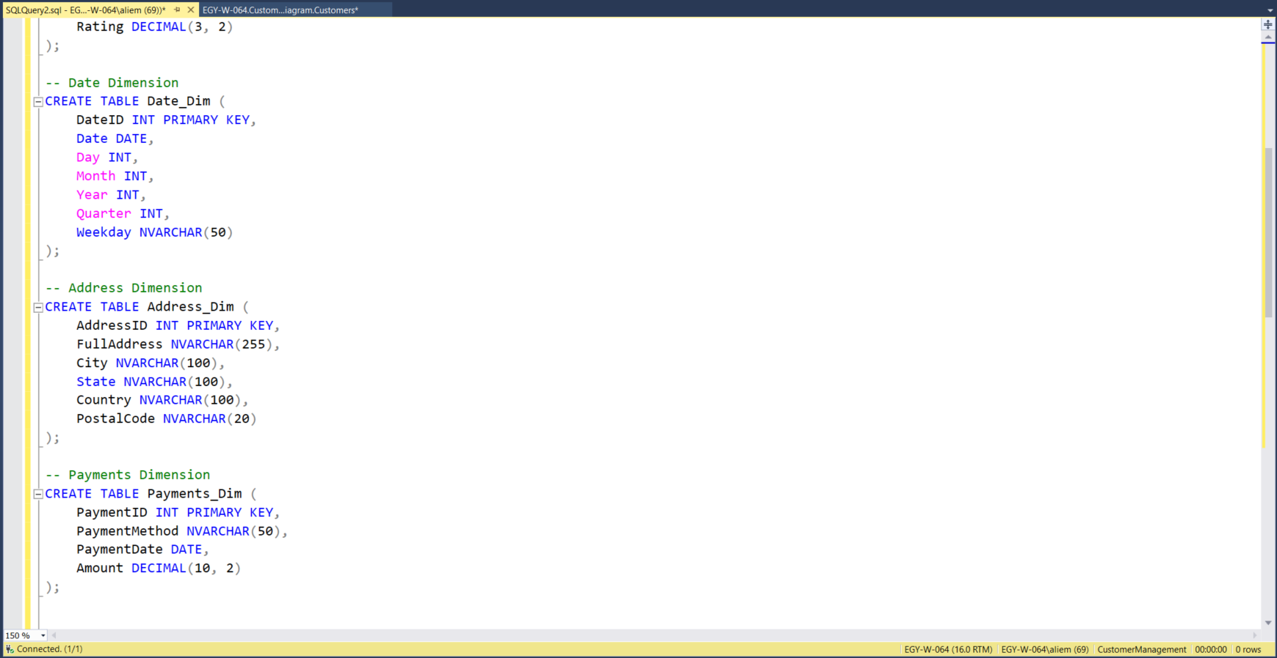

Slide 23
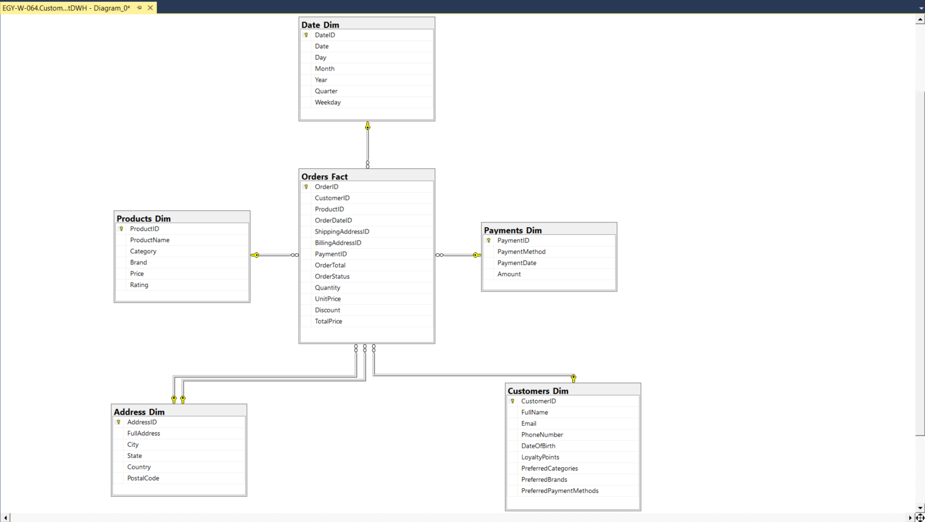
Star Schema on Sql Server

Slide 24
05
ETL
Process

Slide 25
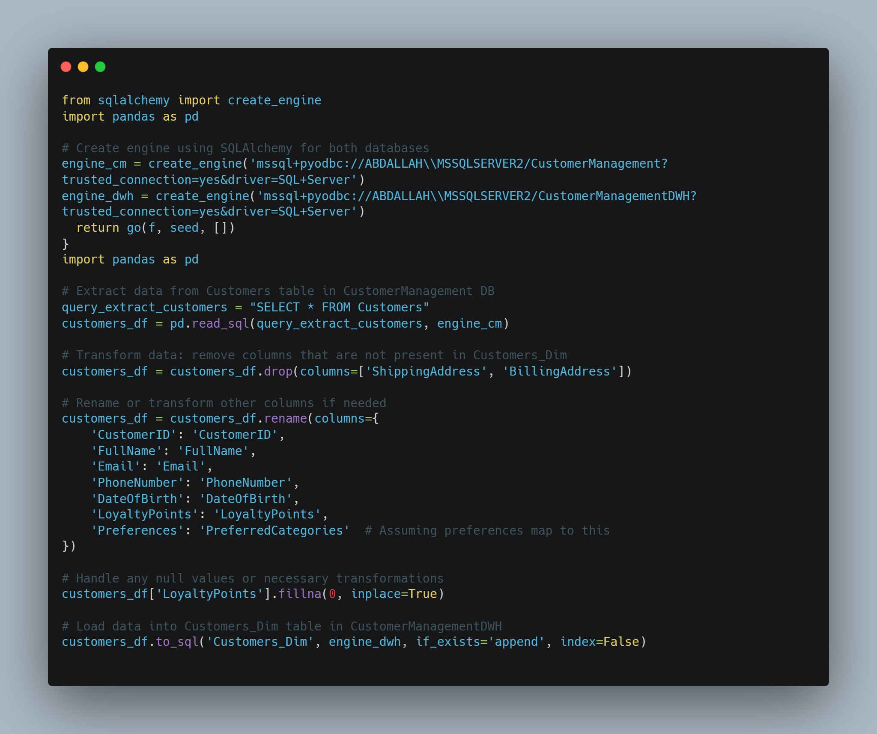

Slide 26
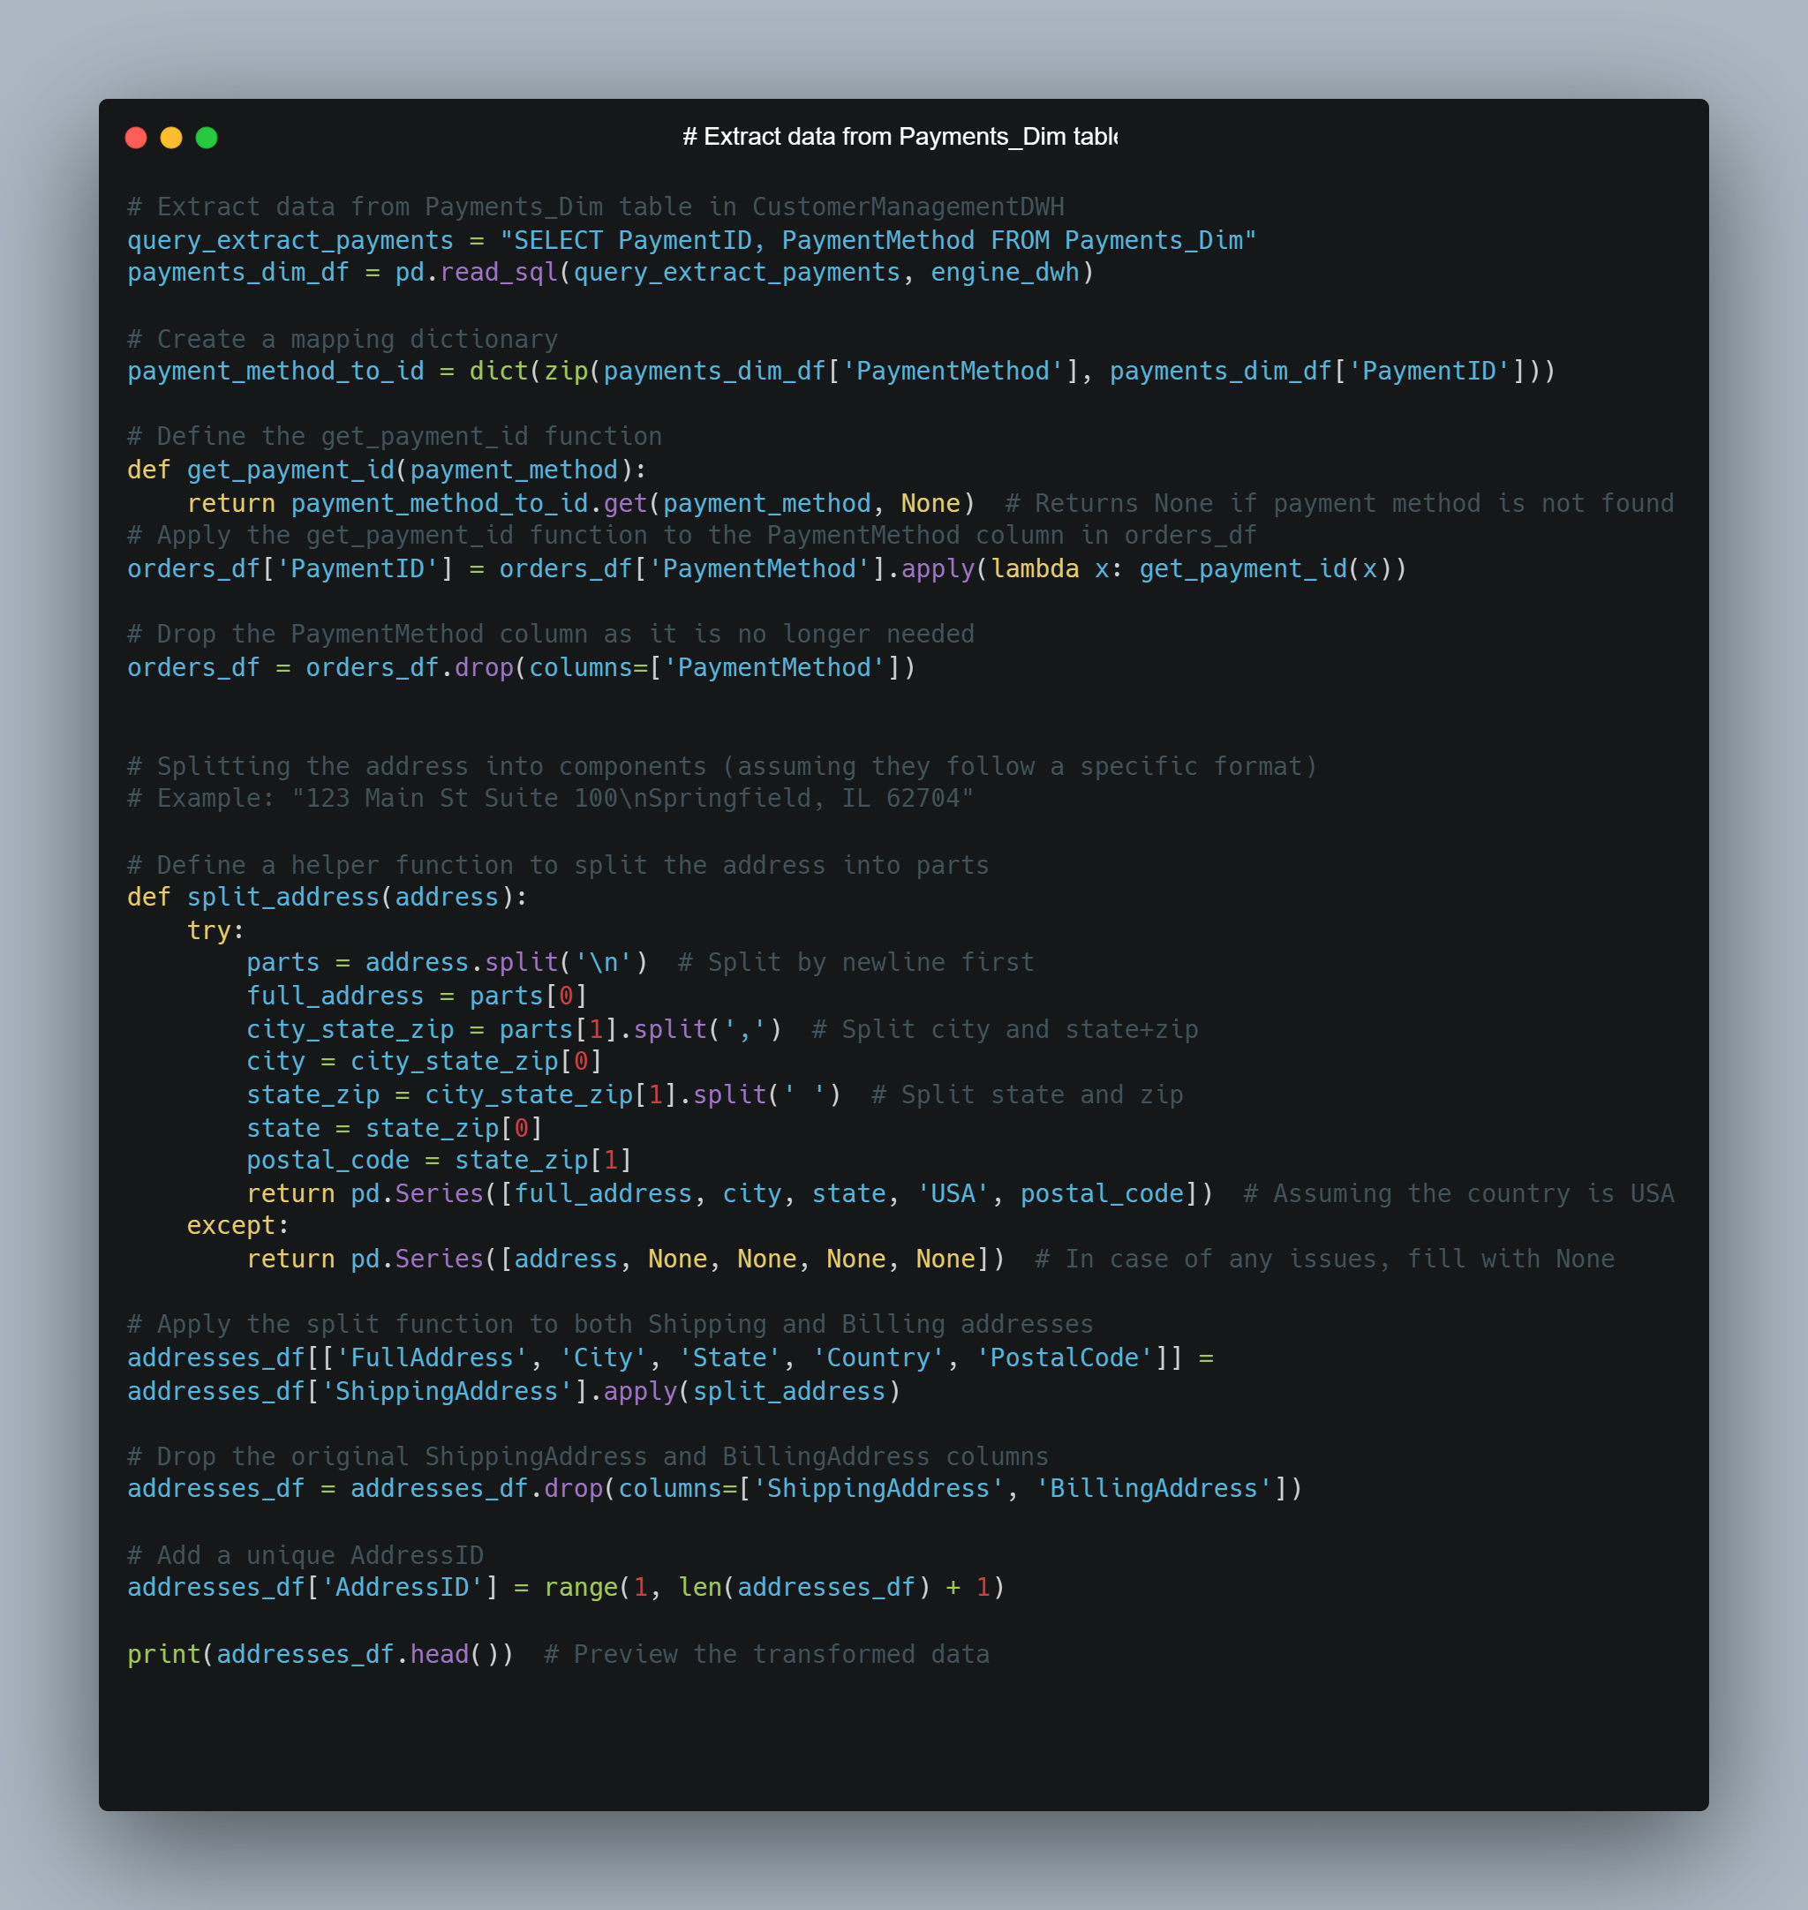

Slide 27
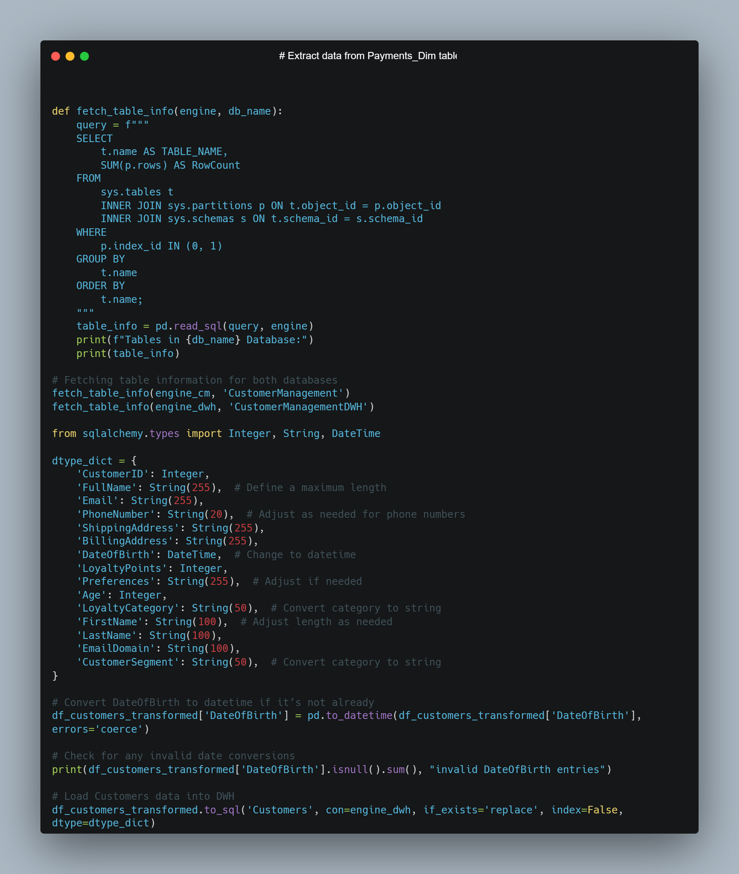

Slide 28
06
Analysis Query

Slide 29
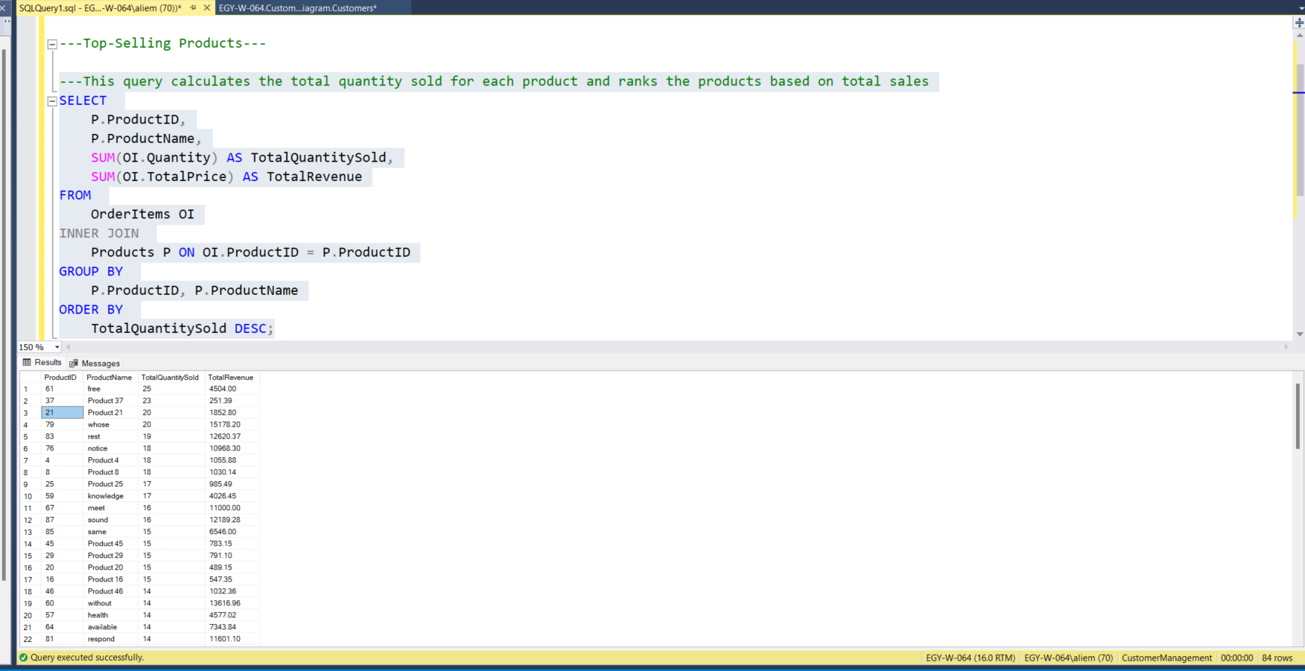

Slide 30
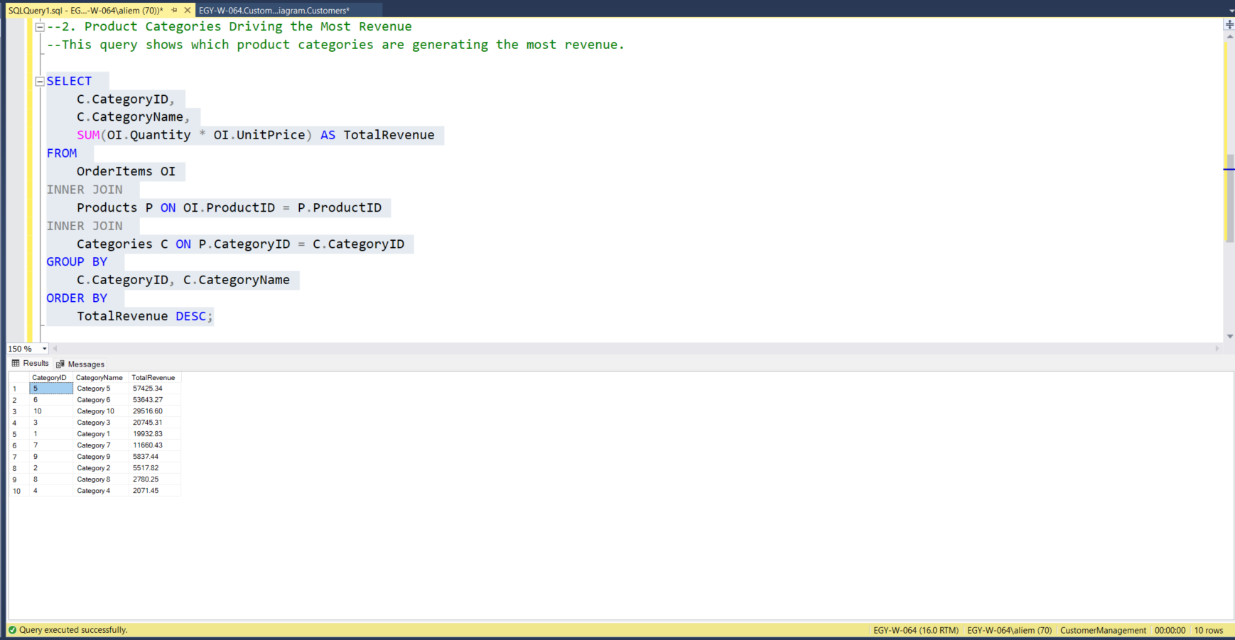

Slide 31
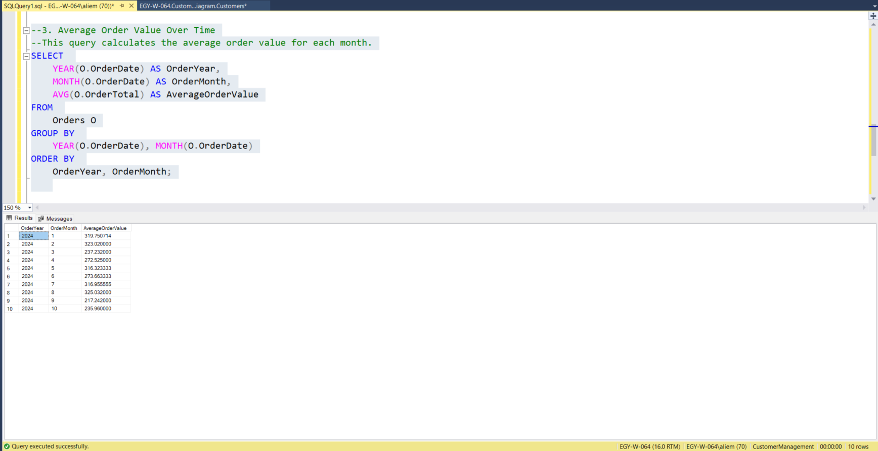

Slide 32
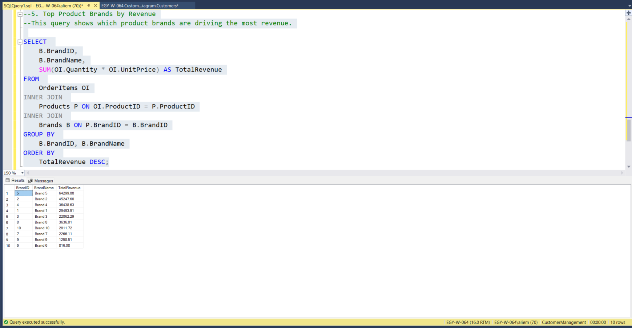

Slide 33
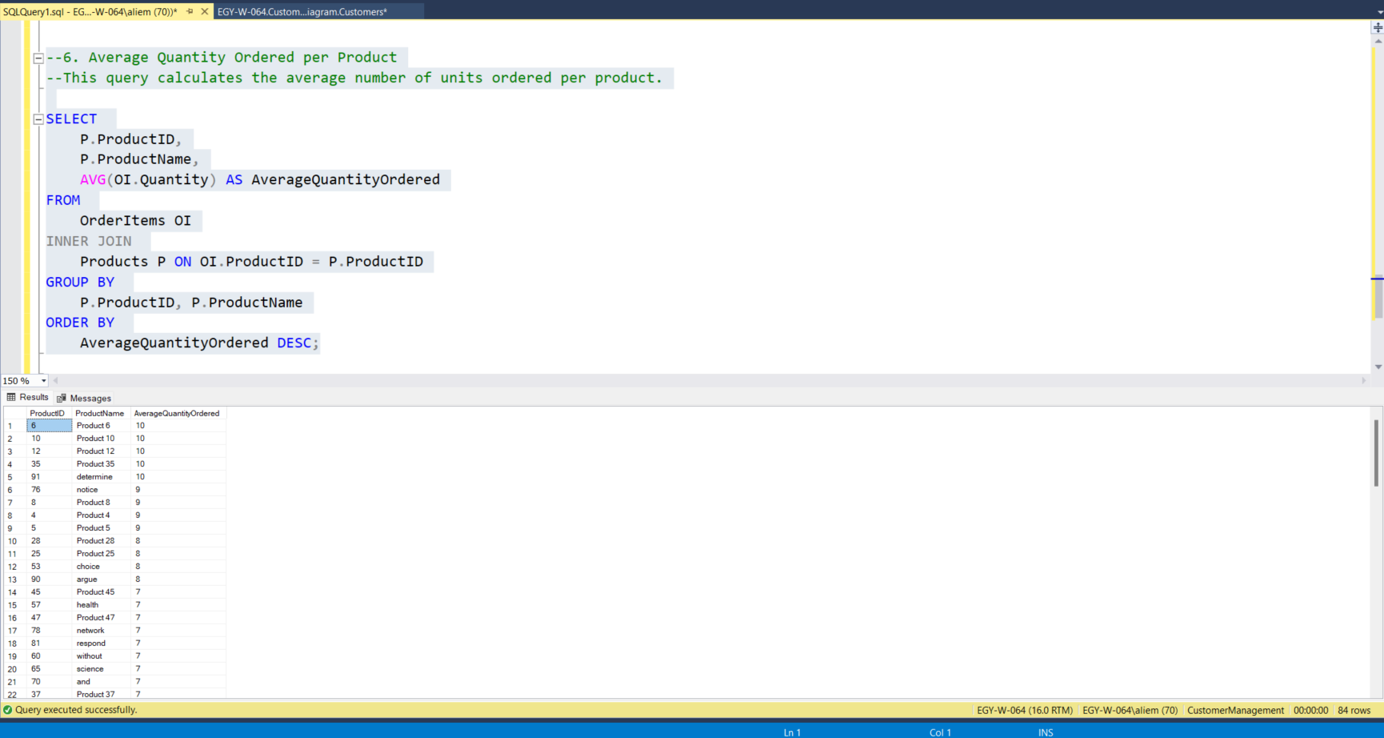
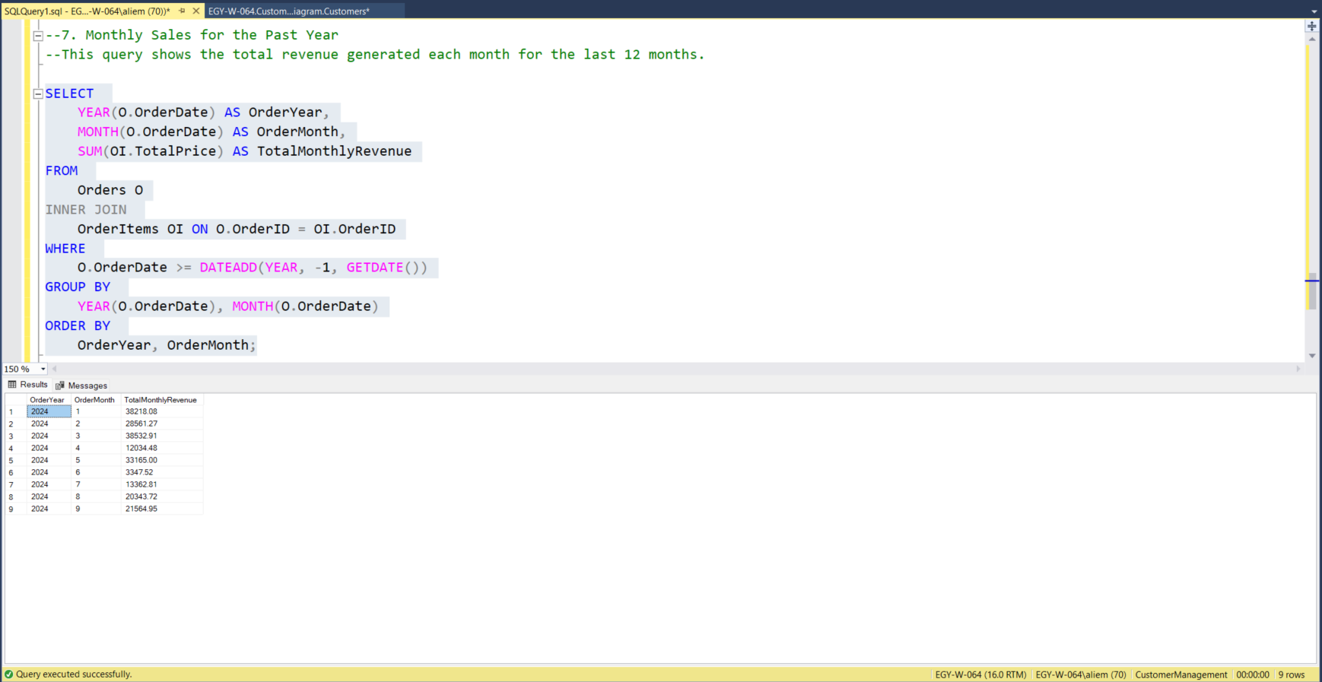

Slide 34
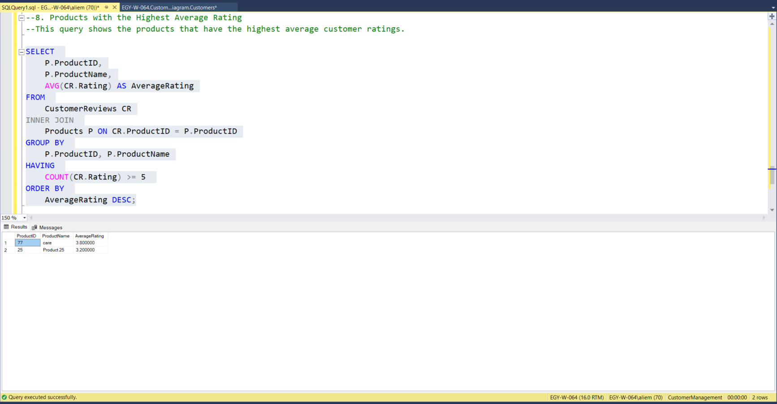

Slide 35
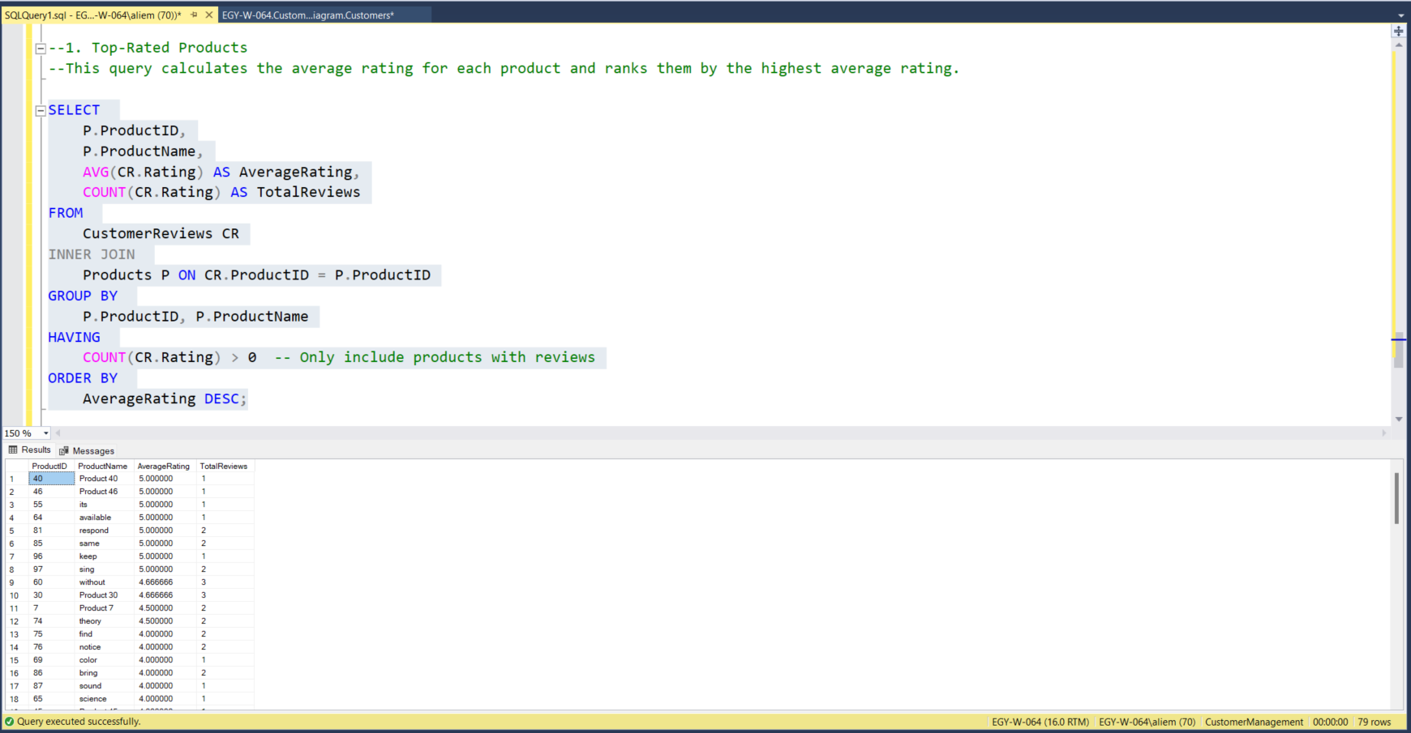

Slide 36
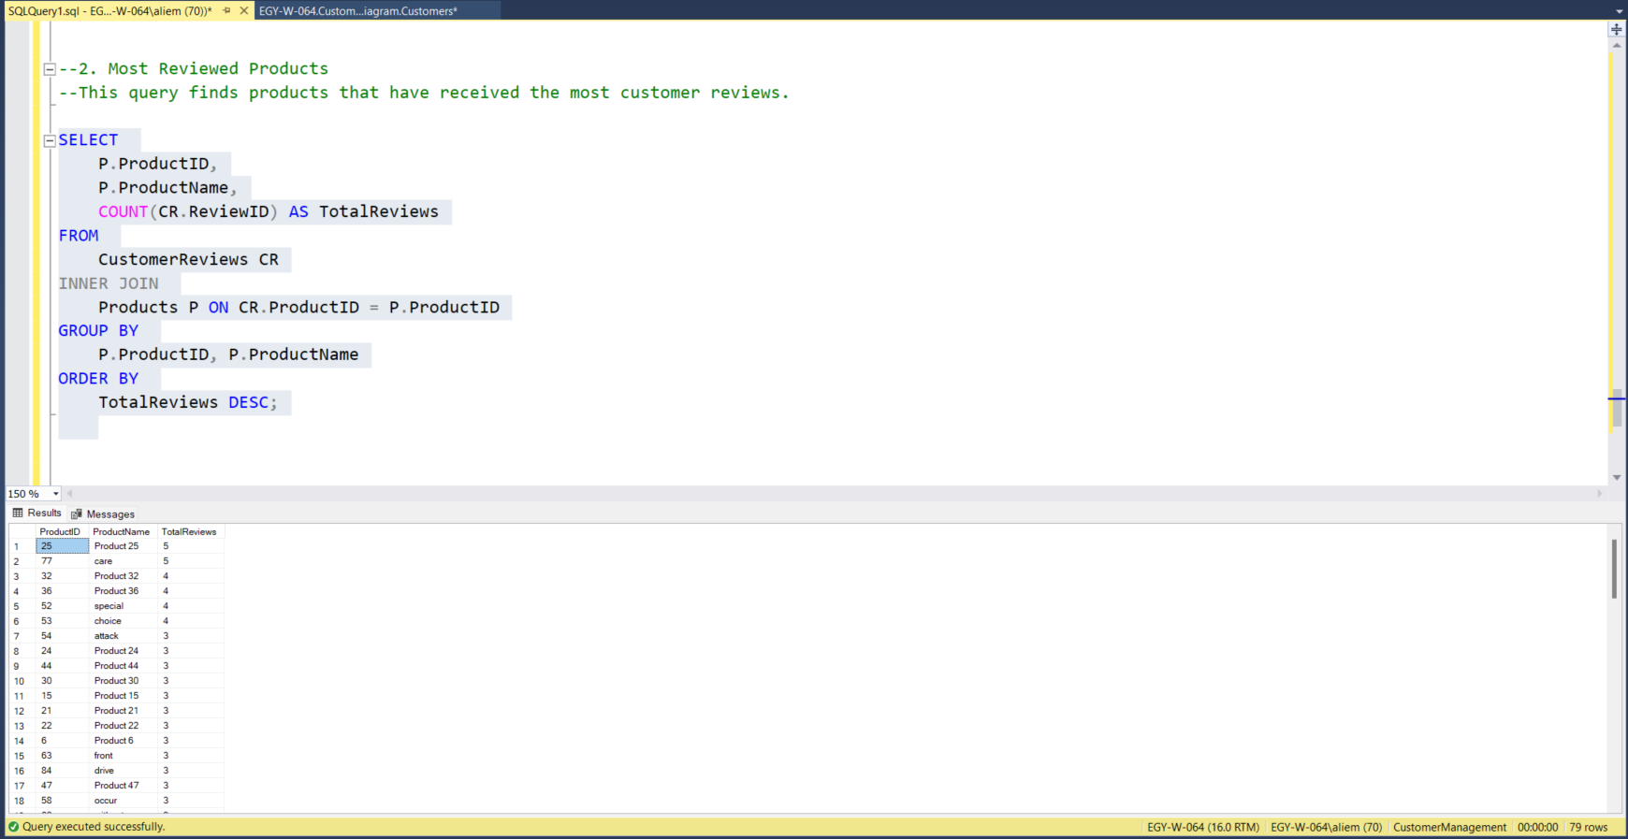
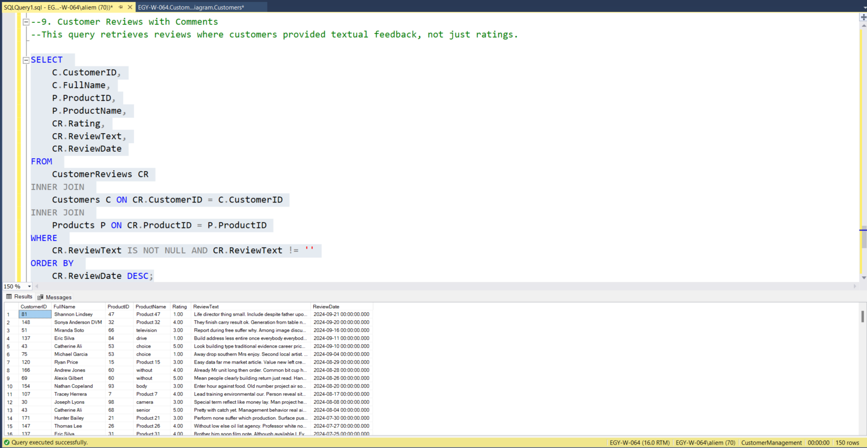

Slide 37
07
Dashboard Creation

Slide 38
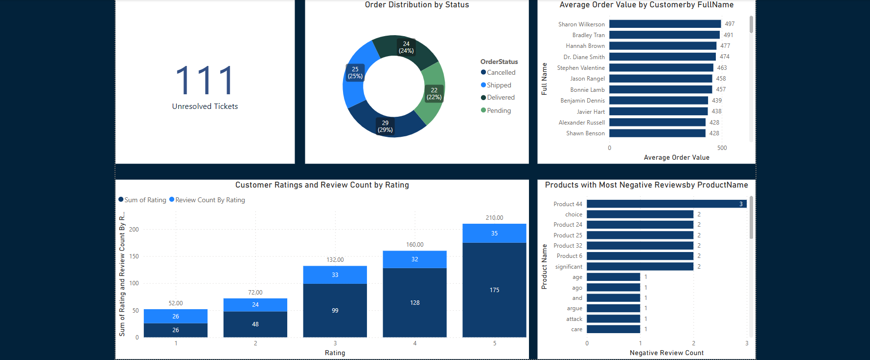
Power Bi Dashboard

Slide 39
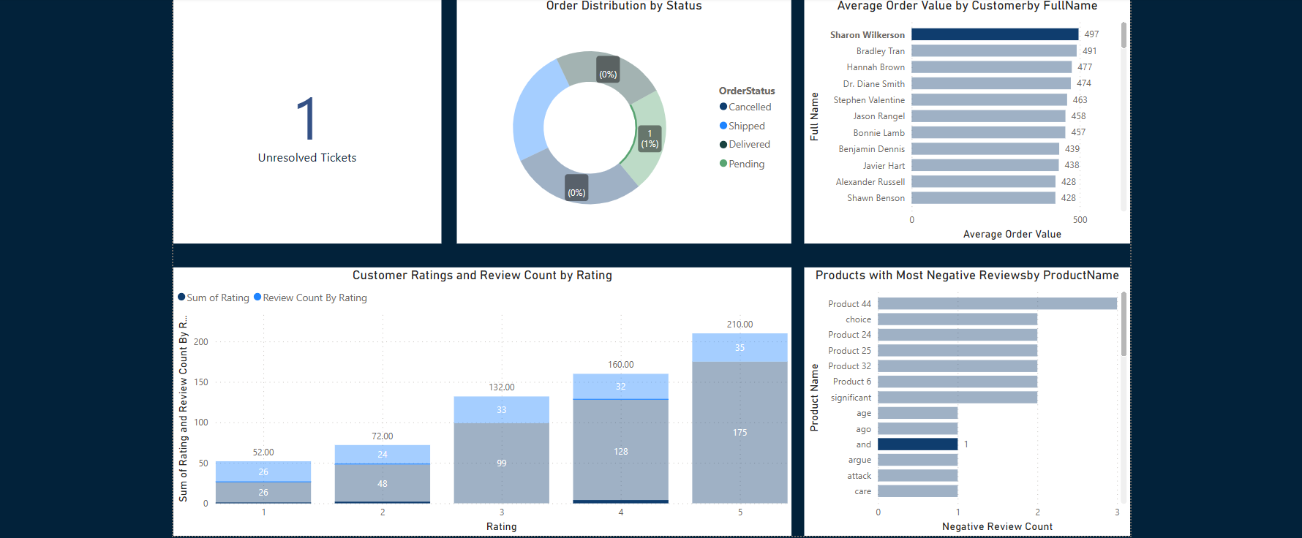
Power Bi Dashboard

Slide 40






OUR TEAM
Ali Emad Abbas Mohammed
Abdallah Hosni
Nour Eldeen Mohamed

